Slide 1
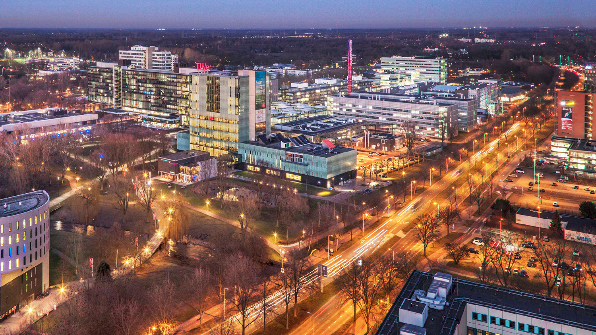
Ideas to discuss
May 29th, 2026
Group 4
Learning control, 4SC070
Notes:
Group 4: Bram, Simon, Vera & Chiron

Slide 2
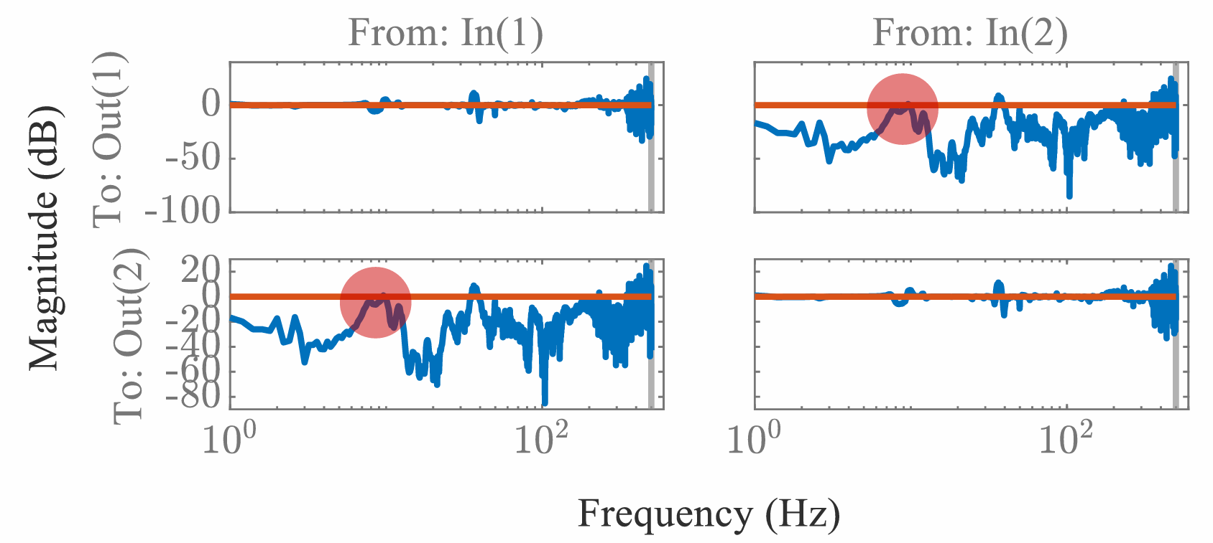
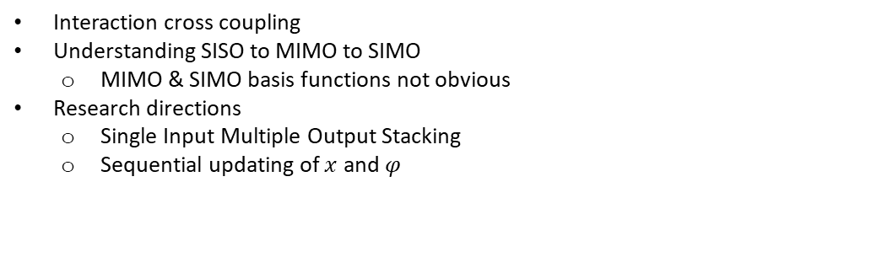
Our approach
Interaction cross coupling
Understanding SISO to MIMO to SIMO
MIMO & SIMO basis functions not obvious
Research directions
Single Input Multiple Output Stacking
Sequential updating of $x$ and $φ$
Notes:
There is notable interaction in the cross coupling. SISO has more obvious basis function compared to SIMO/MIMO due to this interaction. Research directions -> Single Input Multiple Output stacking & Sequential updating of x and phi.

Slide 3



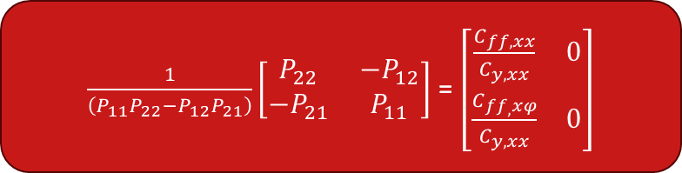
Choosing basis functions - Derivation
$$e_{y}=S\left(C_{y}−PC_{ff}\right)r$$
$$\left[\begin{matrix}C_{y,xx} & 0 \\ C_{y,xφ} & 1\end{matrix}\right]−\left[\begin{matrix}P_{11} & P_{12} \\ P_{21} & P_{22}\end{matrix}\right]\left[\begin{matrix}C_{ff,xx} & 0 \\ C_{ff_{,}xφ} & 0\end{matrix}\right]=\left[\begin{matrix}0 & 0 \\ 0 & 0\end{matrix}\right]$$
$$P^{−1}=C_{ff}{C_{y}}^{−1}$$
=0
$\frac{1}{\left(P_{11}P_{22}−P_{12}P_{21}\right)}\left[\begin{matrix}P_{22} & {−P}_{12} \\ {−P}_{21} & P_{11}\end{matrix}\right]$ = $\left[\begin{matrix}\frac{C_{ff,xx}}{C_{y,xx}} & 0 \\ \frac{C_{ff_{,}xφ}}{C_{y,xx}} & 0\end{matrix}\right]$
Notes:
Ey equation for mimo the same, only transfer matrices
SIMO equation: rphi zero, so we choose the basis functions empty and that results in the zeros and the zero and 1
Just like in the SISO case we want to approximate the inverse of the plant
Show result, here the cross term for the input shapers is no longer necessary due to multiplication
Same denominator
Eventually we want to choose the input shapers cy and the feedforward signal cff in such a way that our error goes to zero, In the simo case we can write this in the following form where the last column here has all zeros do the the reference of phi being zero in Mimo. Then we can rewrite to get the inverse of P, again choose the basis functions to approximate the inverse of plant, but not as straight forward. Rewrite to the the solution …

Slide 4


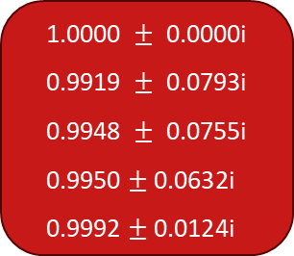

Choosing basis functions - Derivation
$\frac{\frac{A_{1}}{B_{1}}}{\frac{A_{2}}{B_{2}}}$ = $\frac{A_{1}B_{2}}{B_{1}A_{2}}$
Capture poles of $\frac{P_{22}}{\left(P_{11}P_{22}−P_{12}P_{21}\right)}$ and $\frac{{−P}_{21}}{\left(P_{11}P_{22}−P_{12}P_{21}\right)}$ using $C_{y,xx }$
Poles $P_{22}$
Poles $P_{21}$
$$\text{1.0000 }±\text{ 0.0000}\text{i} \\ \text{0.9919 }±\text{ 0.0793}\text{i} \\ \text{0.9948 }±\text{ 0.0755}\text{i} \\ \text{0.9950}±\text{0.0632}\text{i} \\ \text{0.9992}±\text{0.0124}\text{i}$$
$$\text{1.0000 }±\text{ 0.0000}\text{i} \\ \text{0.9919 }±\text{ 0.0793}\text{i} \\ \text{0.9948 }±\text{ 0.0755}\text{i} \\ \text{0.9950}±\text{0.0632}\text{i} \\ \text{0.9992}±\text{0.0124}\text{i}$$
Notes:
--both transfer functions of this form
- We want to capture the poles, since they both share A2 we can focus on B1. Upon checking these values we can see that they are actually the same. Which means that we can use Cyxx to capture poles of both these transfer functions.

Slide 5
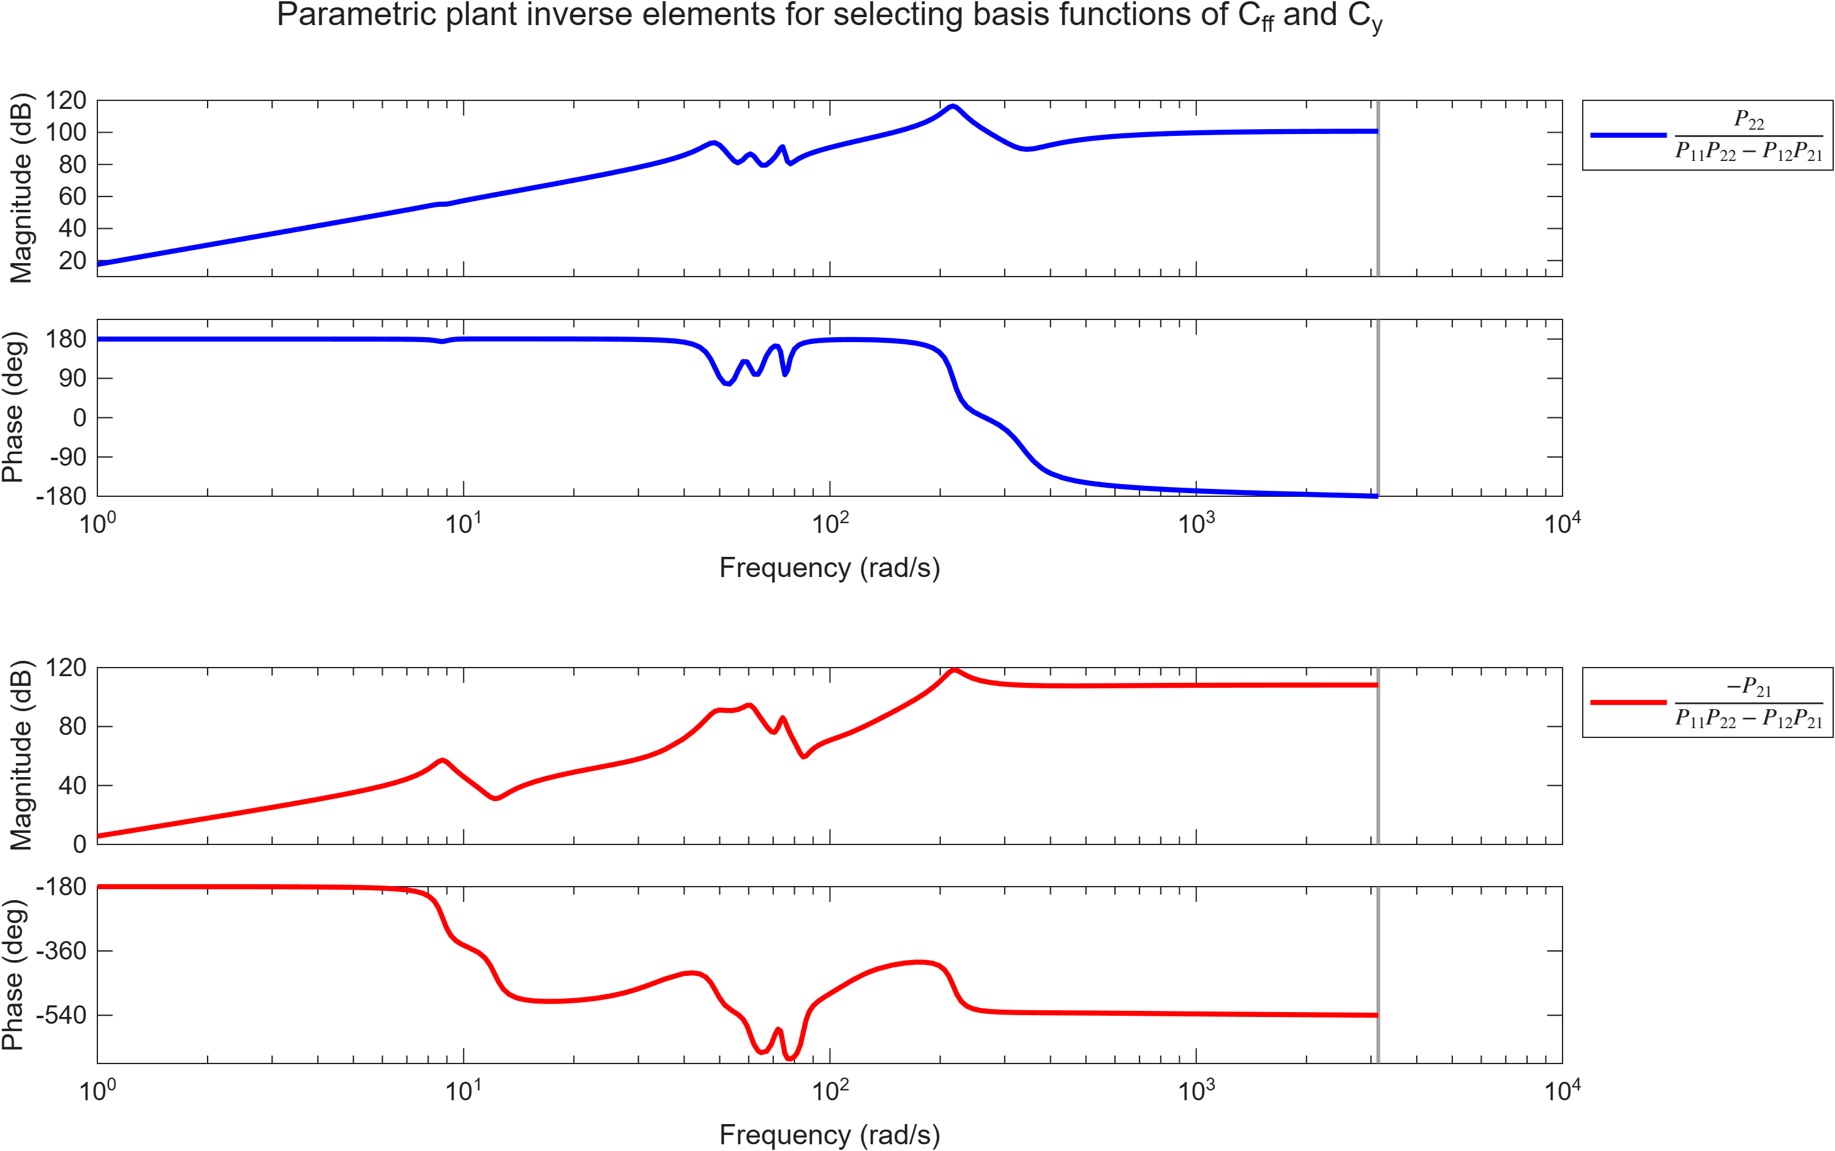
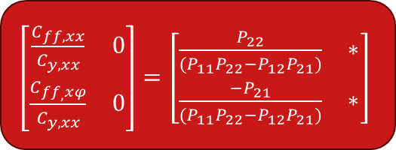
Choosing basis functions - Bode plots
$\left[\begin{matrix}\frac{C_{ff,xx}}{C_{y,xx}} & 0 \\ \frac{C_{ff_{,}xφ}}{C_{y,xx}} & 0\end{matrix}\right]=\left[\begin{matrix}\frac{P_{22}}{(P_{11}P_{22}−P_{12}P_{21})} & ∗ \\ \frac{{−P}_{21}}{(P_{11}P_{22}−P_{12}P_{21})} & ∗\end{matrix}\right]$
Try SISO approach elementwise
High order modes (10/12th order)
Reference excites low frequencies (expected)
Do we need to capture all modes?
Notes:
In SISO, every mode intoduces 2 poles (equivelent for zeros) -> 2 derivatives of the reference signal
Very high order, would end up with a lot of basis functions to capture the system dynamics
However, reference probably only exites the low frequencies, i.e. low frequent modes
Do we need to capture them all?

Slide 6

Choosing basis functions - Amount of basis functions
Original data:
Validation data:
Cost
8 to 12
Overfitting
$$\#θ$$
Only capture modes excited by the reference (not external disturbances)
Introduce basis functions for friction

Slide 7


Optimizing
Batch of data
Parameterization
Optimization algorithm
$$θ^{j+1}$$
Cost $J$

Slide 8

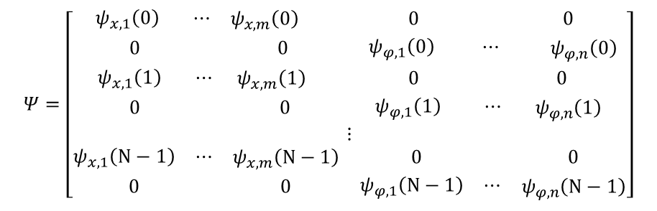
Optimizing – SIMO stacking
S and SP block Toeplitz
Weighting matrices
$$Ψ=\left[\begin{aligned}\begin{matrix}\begin{matrix}{ ψ}_{x,1}\left(0\right) & ⋯\end{matrix} & ψ_{x,m}\left(0\right) & 0 & 0 \\ 0 & 0 & \begin{matrix}ψ_{φ,1}\left(0\right) & ⋯\end{matrix} & ψ_{φ,n}\left(0\right)\end{matrix} \\ \begin{matrix}\begin{matrix}ψ_{x,1}\left(1\right) & ⋯\end{matrix} & ψ_{x,m}\left(1\right) & 0 & 0 \\ 0 & 0 & \begin{matrix}ψ_{φ,1}\left(1\right) & ⋯\end{matrix} & ψ_{φ,n}\left(1\right)\end{matrix} \\ ⋮ \\ \begin{matrix}\begin{matrix}ψ_{x,1}\left(N−1\right) & ⋯\end{matrix} & ψ_{x,m}\left(N−1\right) & 0 & 0 \\ 0 & 0 & \begin{matrix}ψ_{φ,1}\left(N−1\right) & ⋯\end{matrix} & ψ_{φ,n}\left(N−1\right)\end{matrix}\end{aligned}\right]$$
$$β=\left[\begin{matrix}β_{x}\left(0\right) \\ β_{φ}\left(0\right) \\ . \\ . \\ . \\ β_{x}(N−1) \\ β_{φ}(N−1)\end{matrix}\right]$$

Slide 9






Optimizing – SIMO stacking
$$X=\left[\begin{matrix}−{W_{e}}^{\frac{1}{2}}Sψ^{y} & {W_{e}}^{\frac{1}{2}}SPψ^{ff} \\ −{W_{r_{y}}}^{\frac{1}{2}}ψ^{y} & 0 \\ −{W_{r}}^{\frac{1}{2}}ψ^{y} & 0 \\ 0 & {{−W}_{f}}^{\frac{1}{2}}ψ^{ff} \\ 0 & {{−W}_{Δf}}^{\frac{1}{2}}ψ^{ff}\end{matrix}\right]$$
$$Y=\left[\begin{matrix}W_{e}^{\frac{1}{2}}{e_{j}}^{y} \\ {W_{r_{y}}}^{\frac{1}{2}}{r_{j}}^{y} \\ 0 \\ {W_{f}}^{\frac{1}{2}}f_{j} \\ 0\end{matrix}\right]$$
$$J(θ_{Δ}) = \frac{1}{2}{\left\|{Y−Xθ}_{Δ}\right\|}_{2}^{2}$$
Cost function:
Find $Q$ and $L$
Stability
$$θ_{∆}={\left(X^{T}X\right)}^{−1}X^{T}Y$$
$$\overline{σ}\left(Q−LJ\right)<1$$

Slide 10


Optimizing – Sequential update
$$J\left(θ_{Δ,xx},θ_{∆,xφ}\right)=\frac{1}{2}{\left\|Y−X_{xx}θ_{Δ,xx}−X_{xφ}θ_{∆,xφ}\right\|}_{2}^{2}$$
Sequential updates
SISO implementation
1.
$${\hat{θ}}_{∆,xx}^{j+1}=arg\min_{θ_{Δ,xx}^{j+1}}J\left(θ_{Δ,xx}^{j+1},θ_{∆,xφ}^{j}\right)$$
Even trials
Fixed
2.
$${\hat{θ}}_{∆,xφ}^{j+1}=arg\min_{θ_{Δ,xφ}^{j+1}}J\left(θ_{Δ,xx}^{j},θ_{∆,xφ}^{j+1}\right)$$
Odd trials
Fixed

Slide 11
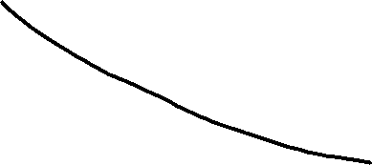



Optimizing – Sequential update
$$\left[\begin{matrix}θ_{Δ,xx}^{j+1} \\ θ_{∆,xφ}^{j+1}\end{matrix}\right]=A\left[\begin{matrix}θ_{Δ,xx}^{j} \\ θ_{Δ,xφ}^{j}\end{matrix}\right]$$
Stability
$$\overline{σ}\left(A\right)<1$$
Cost
$$N_{trials}$$

Slide 12
Appendix

Slide 13
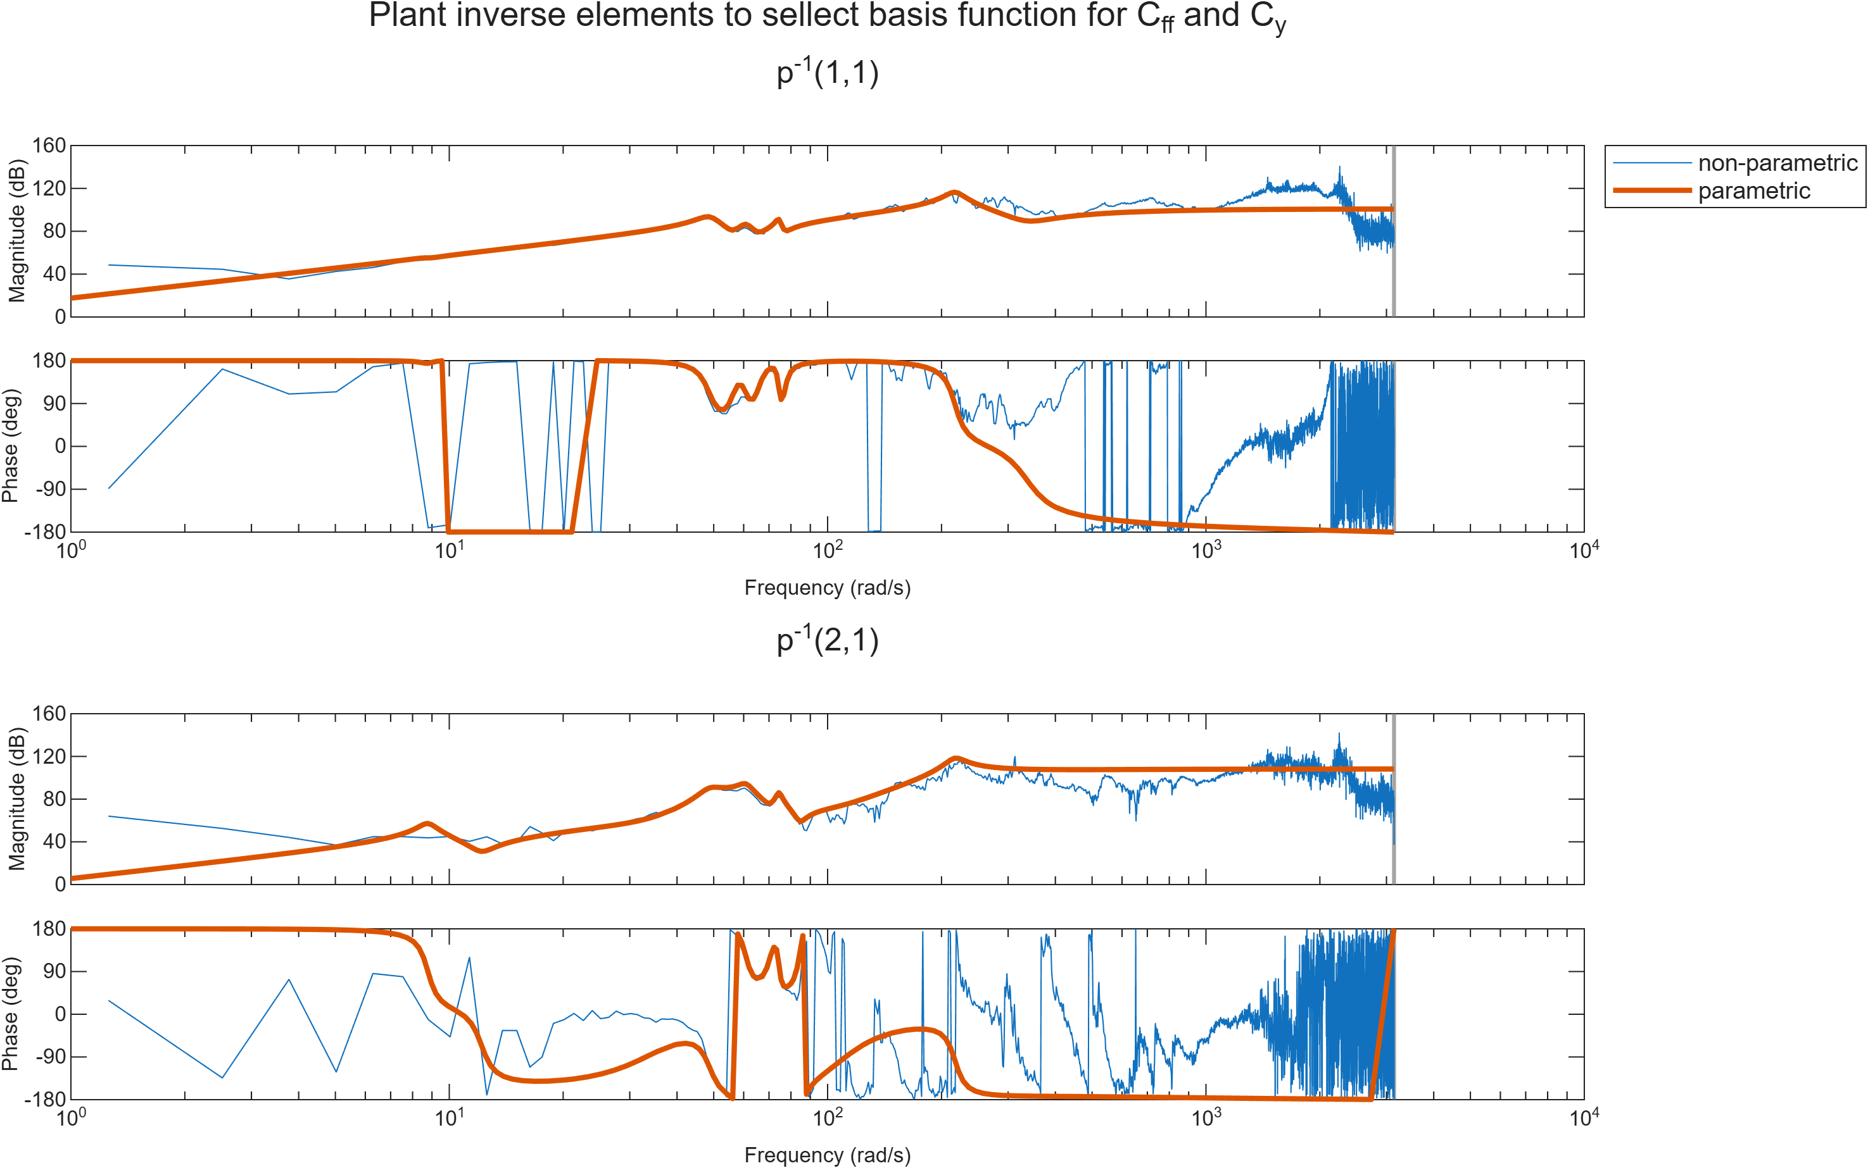

Slide 14
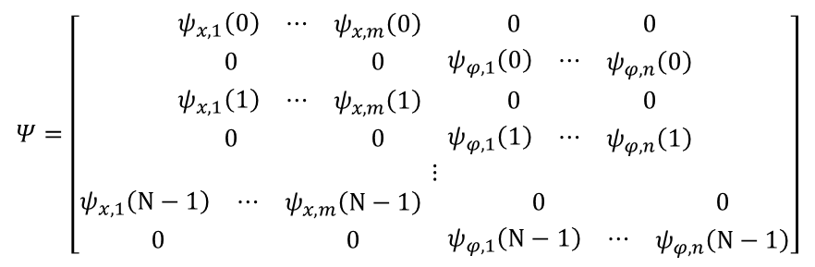
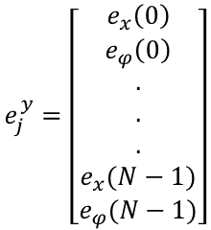

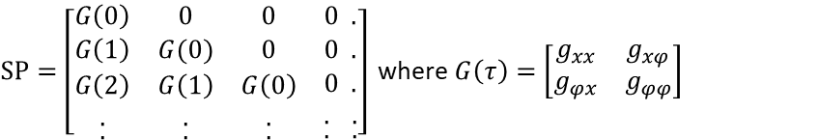
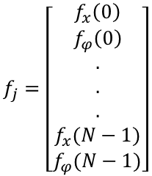
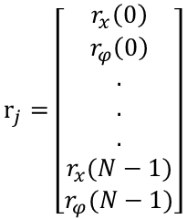
MIMO implementation
$$e_{j}^{y}=\left[\begin{matrix}e_{x}\left(0\right) \\ e_{φ}\left(0\right) \\ . \\ . \\ . \\ e_{x}(N−1) \\ e_{φ}(N−1)\end{matrix}\right]$$
$$r_{j}=\left[\begin{matrix}r_{x}\left(0\right) \\ r_{φ}\left(0\right) \\ . \\ . \\ . \\ r_{x}(N−1) \\ r_{φ}(N−1)\end{matrix}\right]$$
$$f_{j}=\left[\begin{matrix}f_{x}\left(0\right) \\ f_{φ}\left(0\right) \\ . \\ . \\ . \\ f_{x}(N−1) \\ f_{φ}(N−1)\end{matrix}\right]$$
$SP=\left[\begin{matrix}G\left(0\right) & 0 & 0 & 0 . \\ G\left(1\right) & G(0) & 0 & 0 . \\ \begin{aligned}\begin{aligned}G\left(2\right) \\ .\end{aligned} \\ .\end{aligned} & \begin{aligned}\begin{aligned}G\left(1\right) \\ .\end{aligned} \\ .\end{aligned} & \begin{aligned}\begin{aligned}G\left(0\right) \\ .\end{aligned} \\ .\end{aligned} & \begin{aligned}\begin{aligned}0 . \\ . .\end{aligned} \\ . .\end{aligned}\end{matrix}\right]$ where $G\left(τ\right)=\left[\begin{matrix}g_{xx} & g_{xφ} \\ g_{φx} & g_{φφ}\end{matrix}\right]$
$W_{e}=\left[\begin{aligned}\begin{matrix}ω_{e,x} & 0 \\ 0 & ω_{e,φ} \\ ⋮ & ⋱ \\ 0 & ⋯ \\ 0 & ⋯\end{matrix}\begin{matrix} \begin{aligned}0 \\ 0\end{aligned} \\ \begin{aligned} \\ ⋱ \\ 0 \\ 0\end{aligned}\end{matrix}\begin{matrix}\begin{aligned}⋯ \\ ⋯\end{aligned} \\ \begin{aligned} \\ ⋱ \\ { ω}_{e,x} \\ 0\end{aligned}\end{matrix}\begin{matrix}\begin{aligned}0 \\ 0\end{aligned} \\ \begin{aligned}0 \\ 0 \\ ω_{e,φ}\end{aligned}\end{matrix} \\ \end{aligned}\right]$
with $ω_{e,x}=1$and $ω_{e,φ}=\frac{L}{2}\frac{π}{180}$
$$Ψ=\left[\begin{aligned}\begin{matrix}\begin{matrix}ψ_{x,1}\left(0\right) & ⋯\end{matrix} & ψ_{x,m}\left(0\right) & 0 & 0 \\ 0 & 0 & \begin{matrix}ψ_{φ,1}\left(0\right) & ⋯\end{matrix} & ψ_{φ,n}\left(0\right)\end{matrix} \\ \begin{matrix}\begin{matrix}ψ_{x,1}\left(1\right) & ⋯\end{matrix} & ψ_{x,m}\left(1\right) & 0 & 0 \\ 0 & 0 & \begin{matrix}ψ_{φ,1}\left(1\right) & ⋯\end{matrix} & ψ_{φ,n}\left(1\right)\end{matrix} \\ ⋮ \\ \begin{matrix}\begin{matrix}ψ_{x,1}\left(N−1\right) & ⋯\end{matrix} & ψ_{x,m}\left(N−1\right) & 0 & 0 \\ 0 & 0 & \begin{matrix}ψ_{φ,1}\left(N−1\right) & ⋯\end{matrix} & ψ_{φ,n}\left(N−1\right)\end{matrix}\end{aligned}\right]$$

Slide 15
General ideas
MIMO/SIMO implementation
Inertia cross term basis functions
New decoupling matrix (force based on mass/inertia position)
Equivalent plant (SISO)
Separate learning (no decoupling)

Slide 16

Problems
Simulation
Basis functions 1 sample delay due to filtering vs lifted? Do we have to use filters?
Lifted SISO implementation doesn’t seem to show same deadbeat (L and Q problem?)
Suppress vibration during motion?
Basis functions
Error signal cannot be used for learning (which we know will be non-zero)
Cross relation between x-ref and phi basis selection
$$\ddot{φ}=\frac{ML}{2J} \ddot{r}=θ\ddot{r}$$

Slide 17





Choosing basis functions
$$e_{y}=S\left(C_{y}−PC_{ff}\right)r$$
$$P^{−1}=C_{ff}{C_{y}}^{−1}$$
$${P^{−1}=\left[\begin{matrix}P_{11} & P_{12} \\ P_{21} & P_{22}\end{matrix}\right]}^{−1}={\left(P_{11}P_{22}−P_{12}P_{21}\right)}^{−1}\left[\begin{matrix}P_{22} & {−P}_{12} \\ {−P}_{21} & P_{11}\end{matrix}\right]$$
=0
${C_{y}}^{−1}=$ ${\left[\begin{matrix}C_{y,xx} & 0 \\ C_{y,xφ} & 1\end{matrix}\right]}^{−1}= {(C_{y,xx})}^{−1}\left[\begin{matrix}1 & 0 \\ {−C}_{y,xφ} & C_{y,xx}\end{matrix}\right]$
$\left[\begin{matrix}C_{y,xx} & 0 \\ C_{y,xφ} & 1\end{matrix}\right]=\left[\begin{matrix}P_{11} & P_{12} \\ P_{21} & P_{22}\end{matrix}\right]\left[\begin{matrix}C_{ff,xx} & 0 \\ C_{ff_{,}xφ} & 0\end{matrix}\right]$
Eind resultaat laten zien
Zelfde denominator Pinv 11, 21, daarom werkt dit en je Cy, x phi term verdwijnt
Note: herschrijven formules met MIMO notatie, aantonen dat Cyxphi niet nodig is vanuit P^-1 benadering

